Slide 1
Climate change: causes, consequences & possible actions
Graphics from a factsheet of the German National Academy of Sciences Leopoldina
Version 1.0, May 2021
Notes:
Selbst vorstellen

Slide 2
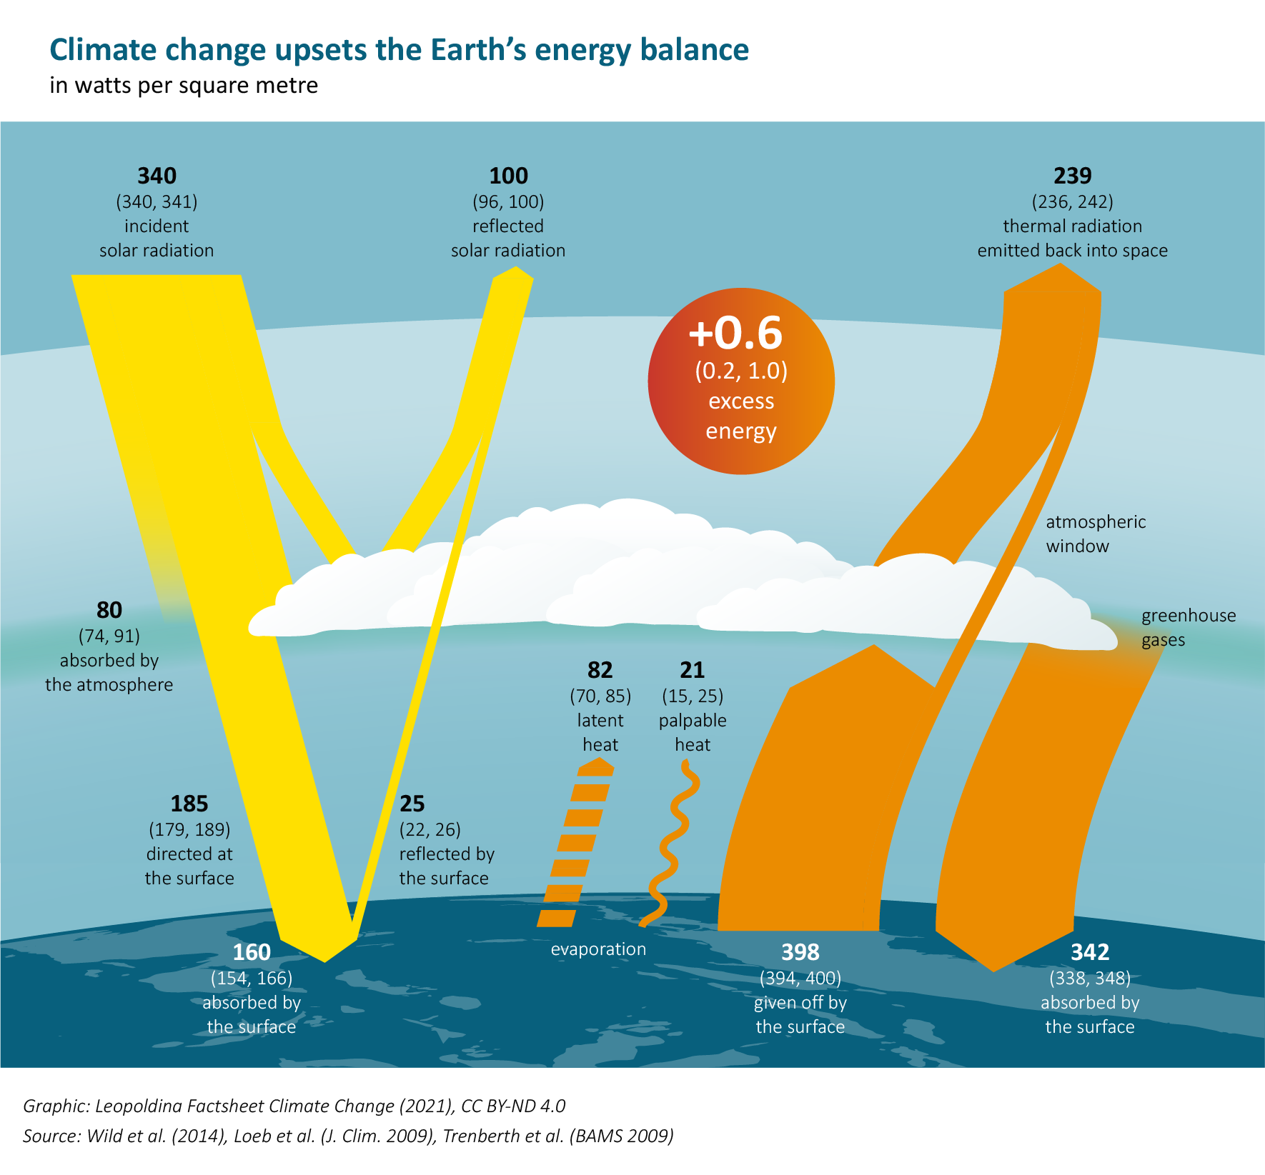
Notes:
What causes climate change? The atmosphere is heated up when increased concentrations of greenhouse gases capture some of the sun’s energy that is otherwise reflected back into space. The increased concentrations of greenhouse gases cause this reflection to take place at higher atmospheric altitudes, where it is colder. This means that less thermal radiation is released back into space. The excess energy is registered as a temperature increase on the Earth’s surface and in the lower atmosphere. The numbers in brackets indicate the range of measurement uncertainty.

Slide 4
Notes:
Direct measurements of the atmosphere’s CO₂ content began on the island of Mauna Loa in 1958. The continuous rise is only interrupted by growing seasons in the Northern Hemisphere. Every year, this results in a periodical drop in CO₂ concentrations in the atmosphere.

Slide 5
Notes:
Temperature rises as a consequence of climate change occur faster over land than over the ocean. Consequently, the average temperature over Germany since 1880 has risen by 2 degrees. The curves illustrate the long-term trend.

Slide 6
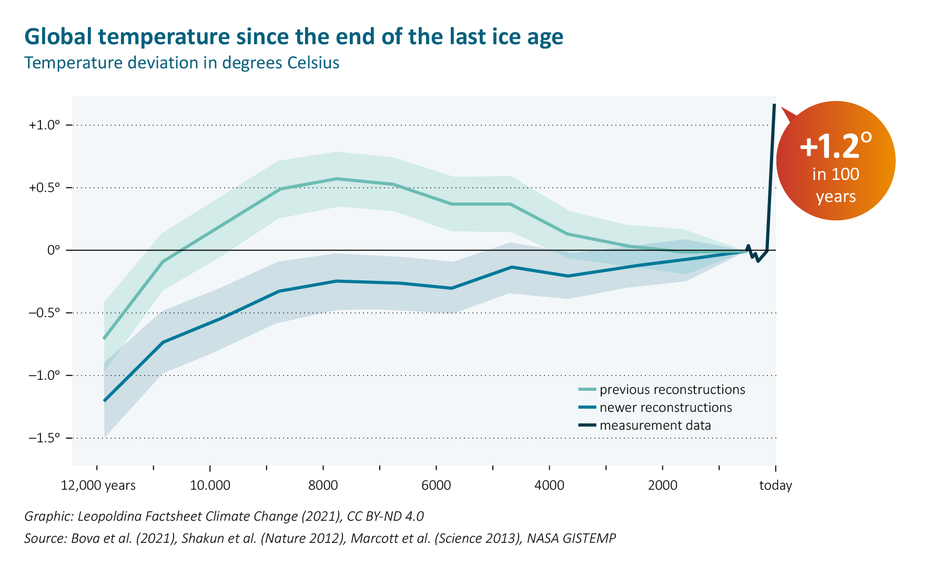
Notes:
The Earth’s climate has changed significantly during the course of the Holocene. But the changes we are currently experiencing are occurring more quickly than they would naturally.

Slide 7
Notes:
The overwhelming portion of carbon dioxide which is emitted annually through human activities comes from the combustion of fossil fuels such as coal, oil and natural gas.

Slide 8
Notes:
Only a portion of the carbon dioxide remains in the atmosphere. The ocean and terrestrial ecosystems (such as forests) also absorb carbon dioxide. Without these sinks, climate change would be even more extreme.

Slide 9
Notes:
Temperature and precipitation records continue to be broken worldwide with greater frequency.

Slide 10
Notes:
Sea level data and satellite measurements show that the sea level has risen by approximately 20 centimetres since 1900.

Slide 11
Notes:
The surface area at the North Pole which is covered by ice in summer has been continuously receding for decades.

Slide 12
Notes:
Each year, 10,000 selected trees are evaluated for the forest status report. The past years’ drought makes trees more susceptible to pests and has led to an extreme spike in death, particularly of spruces, but also of oak and pine trees.

Slide 13
Notes:
Between 1985 and 2012, the proportion of damaged corals has risen to about 25%. The reason for coral bleaching and subsequent death is climate warming. By 2050, nearly all coral reefs could be affected.

Slide 14
Notes:
The map illustrates the proportion of global grassland which was afflicted by drought in the period between 2004 and 2018.

Slide 16
Notes:
Geological and ecological systems around the globe are losing their equilibrium as a result of climate change. Some of these changes have a reinforcing effect on climate change, making it accelerate to the point that it can no longer be stopped.

Slide 18
Notes:
If the global rise in temperature is to be kept to a maximum of 2 degrees, a total of only about 1050 billion tonnes (gigatonnes) of CO₂ can still be emitted. Limiting global warming to just 1.5 degrees would mean restricting the total amount of emissions to less than 300 gigatonnes of CO₂. The longer we wait to reduce emissions, the quicker and more radical later climate protection measures will need to be.

Slide 19
Notes:
Based on emissions projections from countries around the world, it is clear that the intended emissions reduc- tions are completely insufficient for achieving the targets laid out in the Paris Agreement. Limiting climate change to 2 °C would require cutting down the already intended CO₂ emissions reductions by a further 10–15 gigatonnes by 2030. To limit it to 1.5 °C would mean a further reduction of 23–27 gigatonnes.

Slide 21
Notes:
A carbon price serves as an effective tool for creating incentives to minimise emissions. However, this only works if the price is set high enough. The price for the vast majority of emissions is set at zero, or it is much too low to actually provide an incentive to control emissions. The data refer to 42 OECD and G20 countries responsible for 80% of global emissions.

Slide 22
Notes:
Only a portion of the carbon dioxide remains in the atmosphere. The ocean and terrestrial ecosystems (such as forests) also absorb carbon dioxide. Without these sinks, climate change would be even more extreme. It is unclear where a small portion of emissions – about 4% – remains. This is illustrated by the discrepancy visible between sources and sinks.

Slide 23
Notes:
In many countries, for instance those in Asia, emissions have skyrocketed in the last years. However, many goods produced there are consumed in western countries. The emissions from the production of goods in one country which are consumed in another raise the issue of just distribution of the remaining CO₂ budget.

